Slide 1
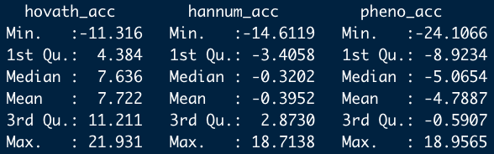
All bladder cancer patients
(n = 678)

Slide 2
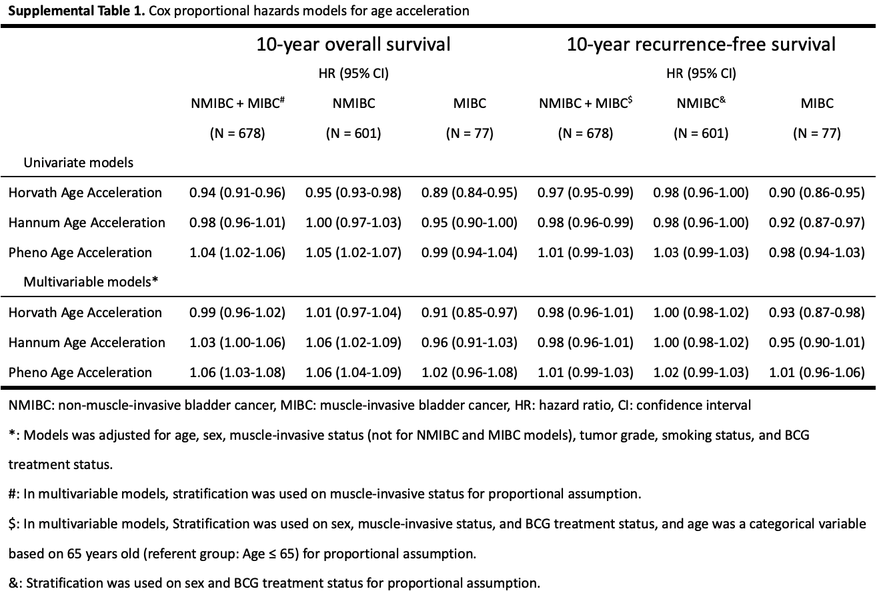
Violates proportional assumption
Red Square: significant results

